Slide 1
Local Shading Models
Dr Mayuri A v r
Senior assistant professor
ViT bhopal

Slide 2
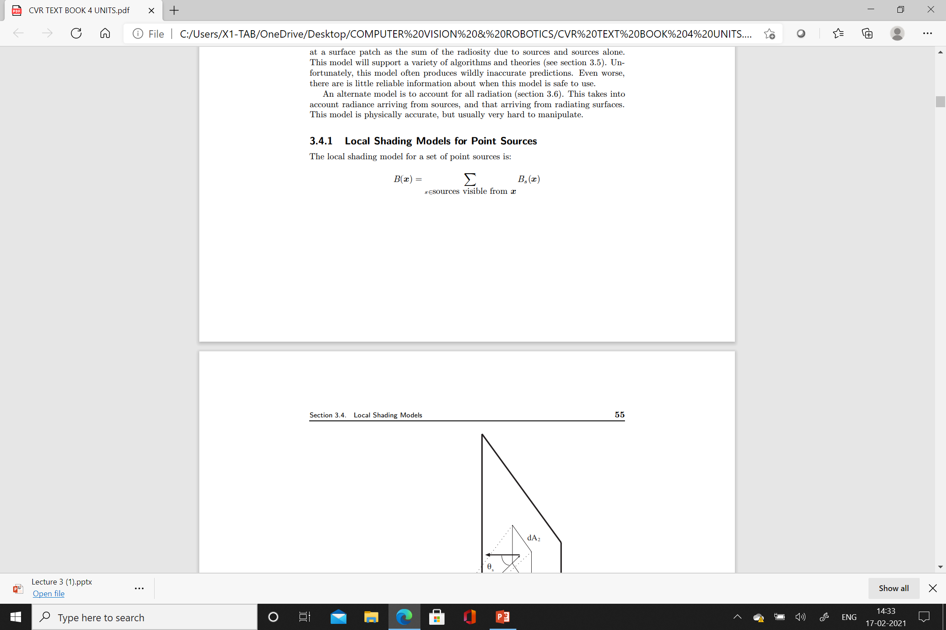
Local Shading Models for Point Sources
Consider that all the points in a given region can see the same sources
Then we could add all the source vectors to obtain a single virtual Source.
where B_{s}(x) is the radiosity due to source s

Slide 3
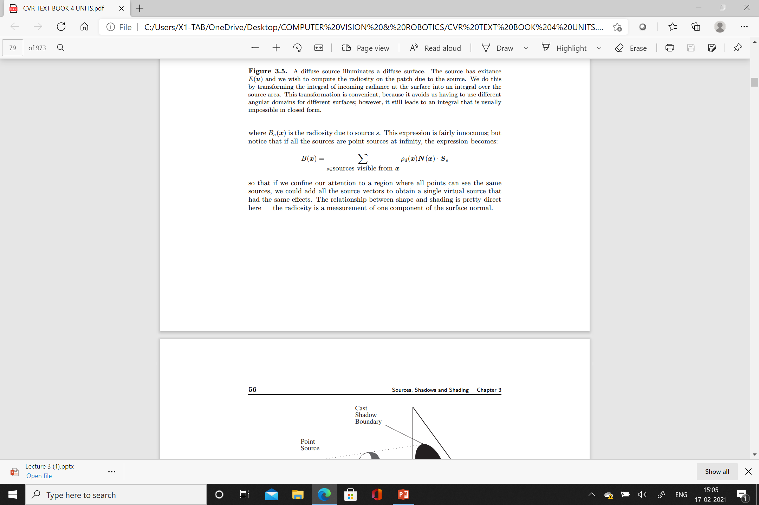
If all the sources are point sources at infinity, then the expression becomes

Slide 4
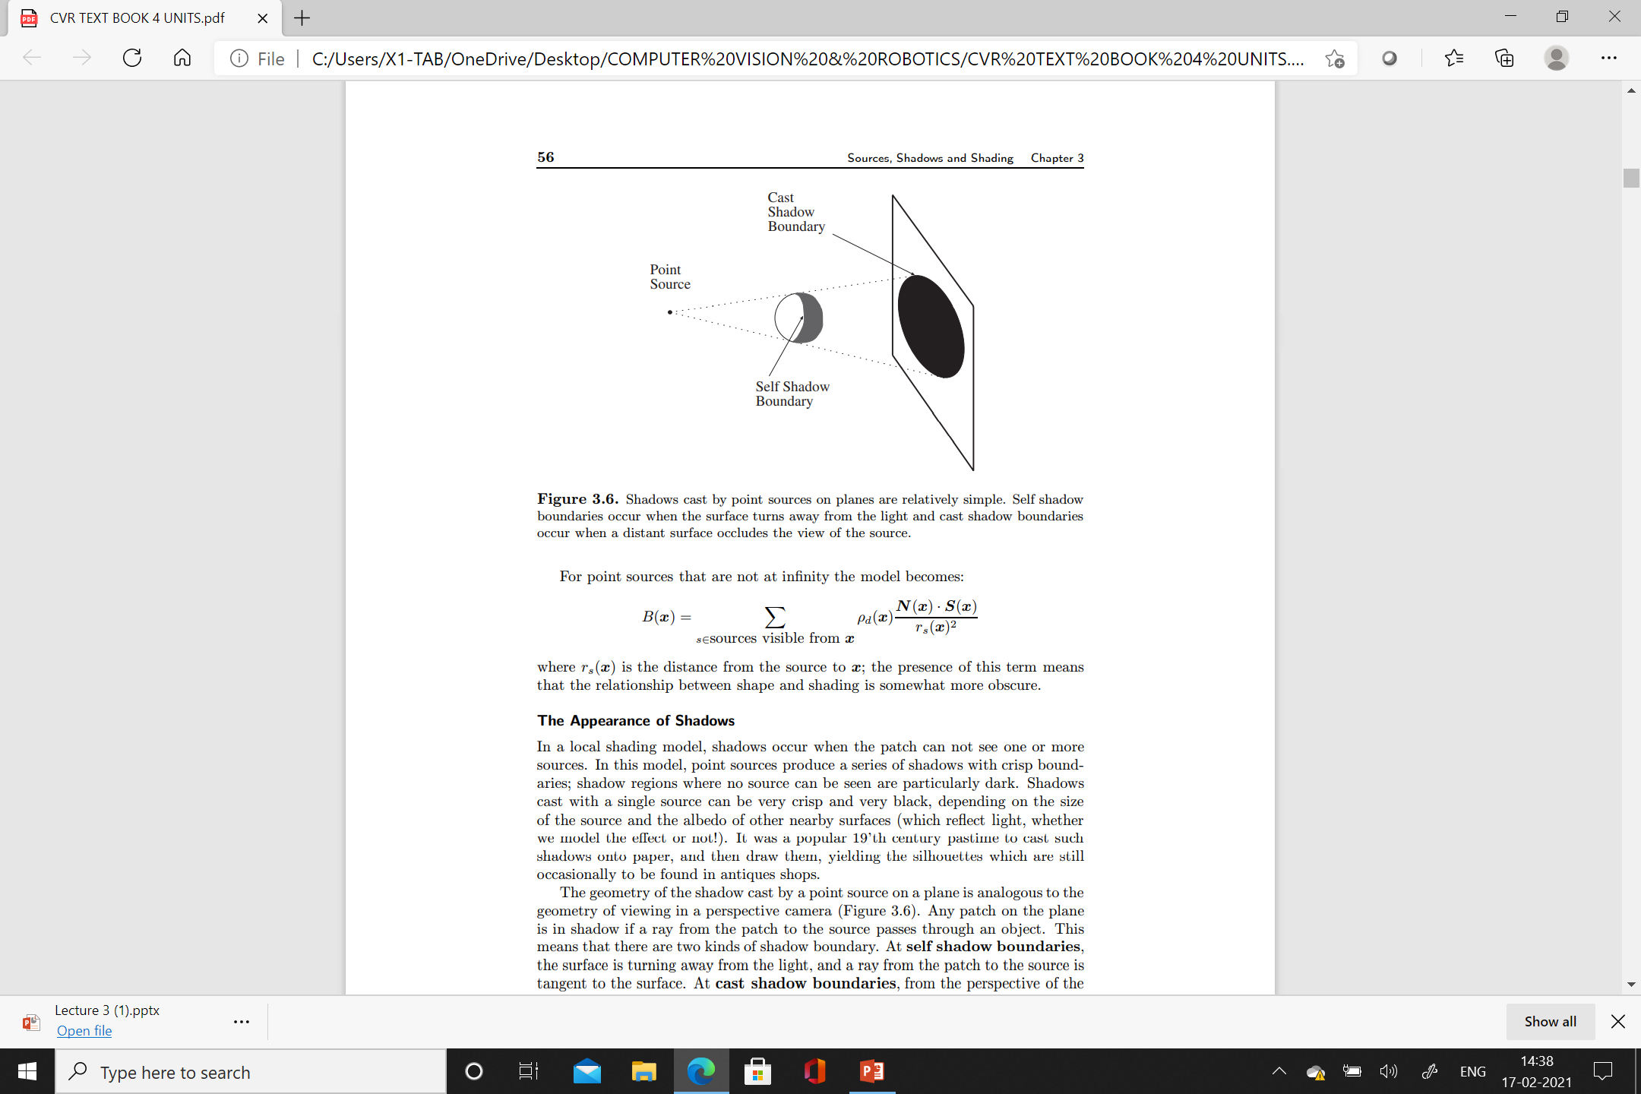
If Point sources that are not at infinity the model become
where r_{s}(x) is the distance from the source to x;
the presence of this term means that the relationship between shape and shading is somewhat more obscure.

Slide 5
Appearance of Shadows
In a local shading model, shadows occur when the patch can not see one or more sources.
In this model, point sources produce a series of shadows with crisp boundaries;
shadow regions where no source can be seen are particularly dark.
Shadows cast with a single source can be very crisp and very black,
This depends on the size of the source and the albedo of other nearby surfaces.

Slide 6
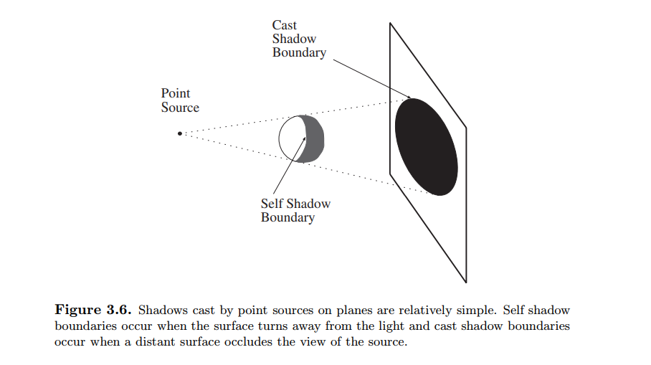

Slide 7
The geometry of the shadow cast by a point source on a plane is analogous to the geometry of viewing in a perspective camera
Any patch on the plane is in shadow if a ray from the patch to the source passes through an object.
This means that there are two kinds of shadow boundary.
At self shadow boundaries, the surface is turning away from the light, and a ray from the patch to the source is tangent to the surface.
At cast shadow boundaries, from the perspective of the patch, the source suddenly disappears behind an occluding object.
However, Shadows cast onto curved surfaces can have extremely complex geometries.

Slide 8
If there are many sources, the shadows will be less dark (except at points where no source is visible) and there can be very many qualitatively distinct shadow regions (each source casts its own shadow — some points may not see more than one source).
One example of this effect occurs in televised soccer matches — because the stadium has multiple bright distant point-like illuminants spaced evenly around the perimeter of the stadium, there is a set of shadows radiating evenly around each player’s feet.
These shadows typically become brighter or darker as the player moves around, usually because the illumination due to other sources and to interreflections in the region of the shadow increases or decreases.

Slide 9
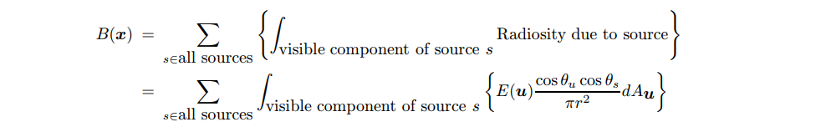
Area Sources and their Shadows
The local shading model for a set of area sources is significantly more complex, because it is possible for patches to see only a portion of a given source.
Assume that E is constant over the source

Slide 10
Area sources do not produce dark shadows with crisp boundaries.
This is because, from the perspective of a viewing patch, the source appears slowly from behind the occluding object (think of an eclipse of the moon — it is an exact analogy).
It is common to distinguish between points in the umbra (a Latin word, meaning “shadow”) — which cannot see the source at all — and points in the penumbra (a compound of Latin words, meaning “almost shadow”) — which see part of the source.
The vast majority of indoor sources are area sources of one form or another, so the effects are quite easy to see;
hold an arm quite close to the wall (for reasons we will discuss below) and look at the shadow it casts — there is a dark core, which gets larger as the arm gets closer to the wall; this is the umbra — surrounded by a lighter region with a fuzzier boundary (the penumbra)

Slide 11
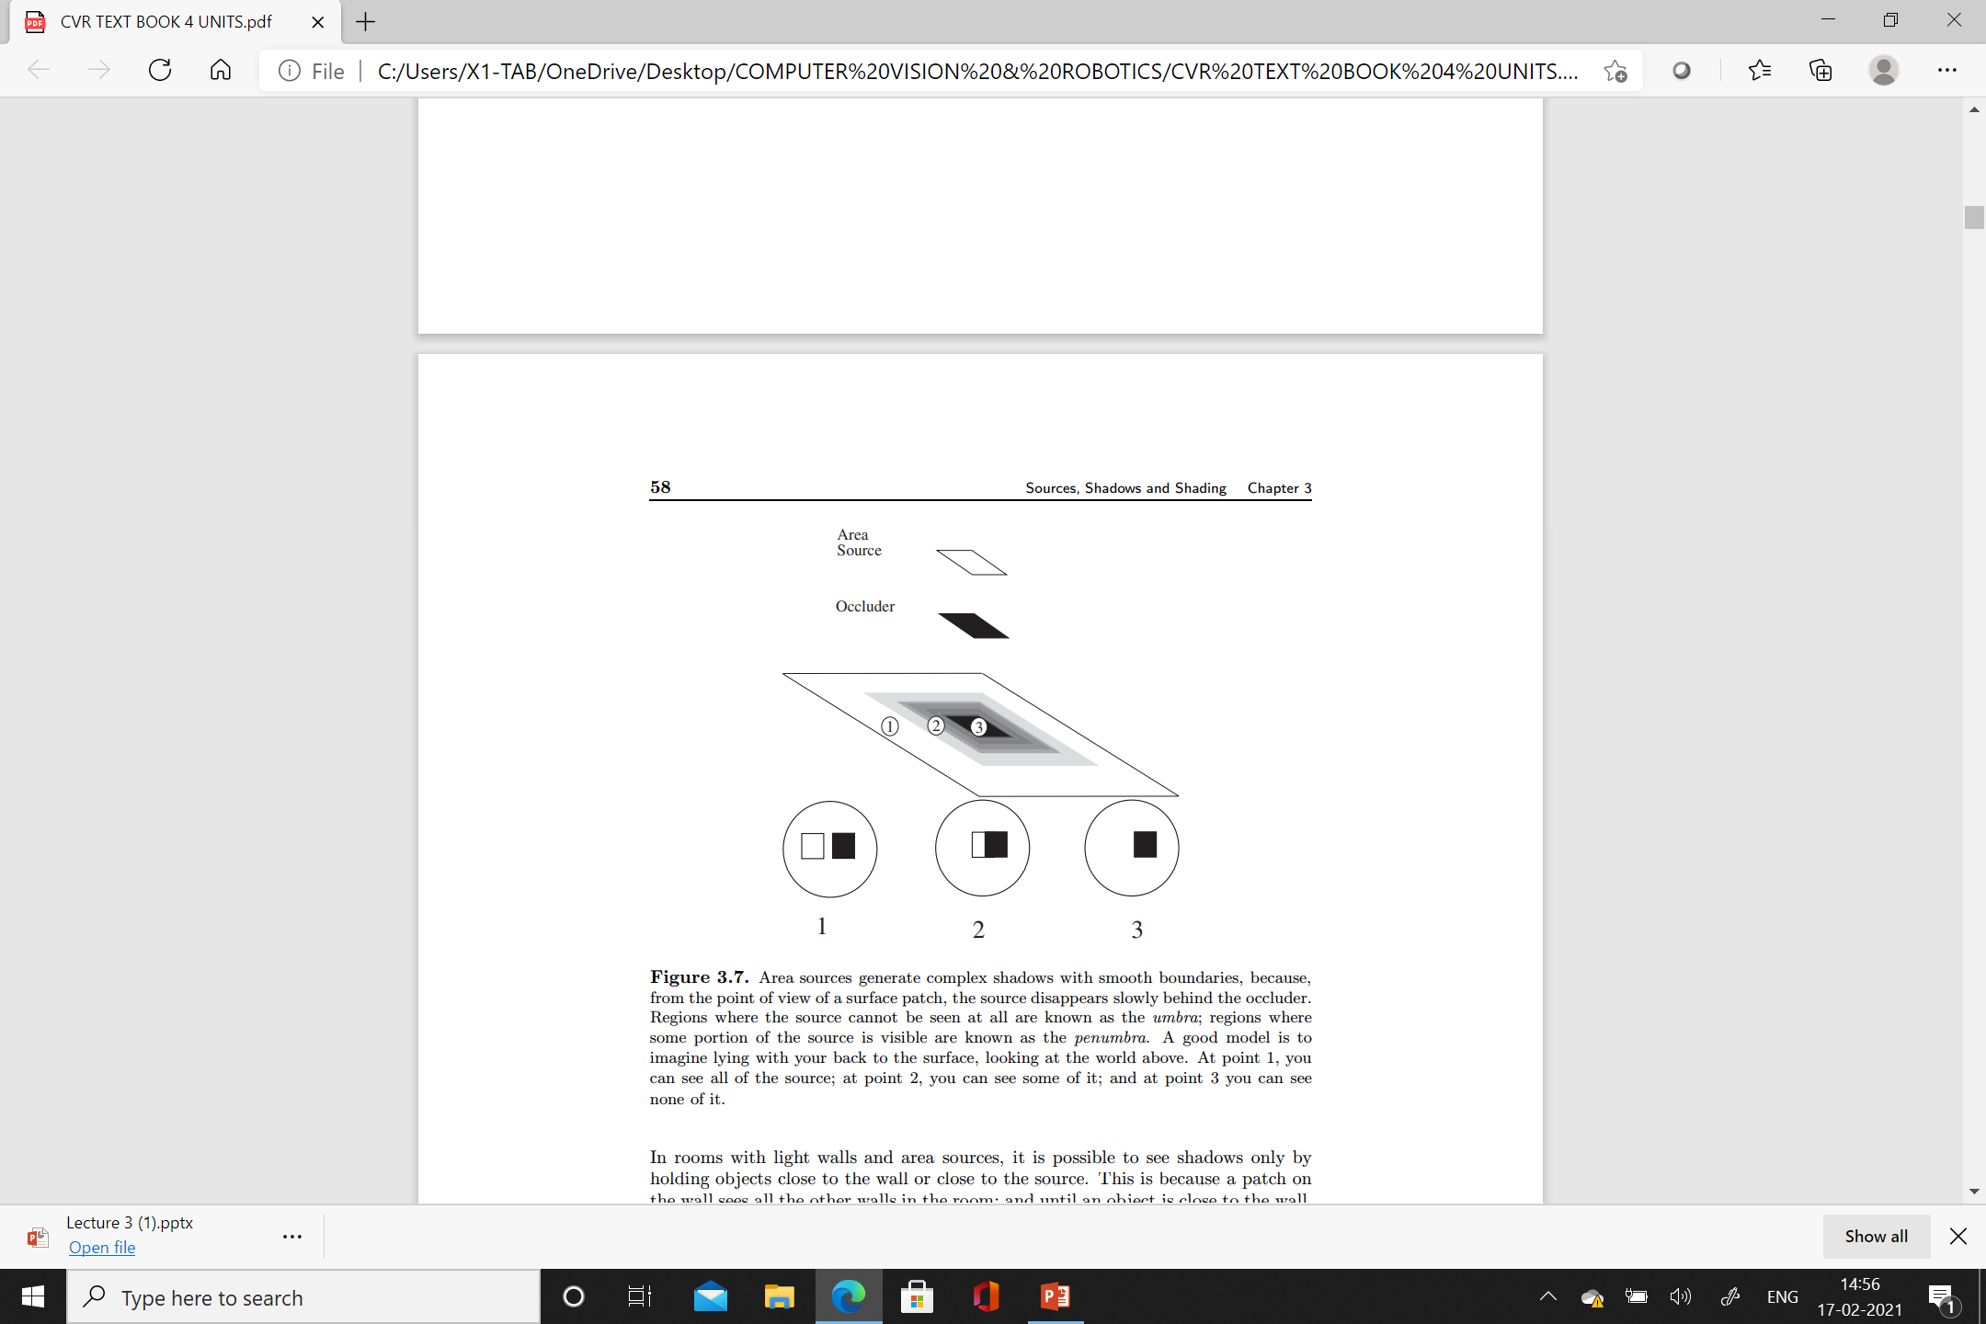

Slide 12
Ambient Illumination
One problem with local shading models is that they predict that some shadow regions are arbitrarily dark, because they cannot see the source.
This prediction is inaccurate in almost every case, because shadows are illuminated by light from other diffuse surfaces.
This effect can be very significant.
In rooms with light walls and area sources, it is possible to see shadows only by holding objects close to the wall or close to the source.
This is because a patch on the wall sees all the other walls in the room; and until an object is close to the wall, it blocks out only a very small fraction of each patches visual hemisphere

Slide 13
For some environments, the total irradiance a patch obtains from other patches is roughly constant and roughly uniformly distributed across the input hemisphere.
This must be true for the interior of a sphere with a constant distribution of radiosity (by symmetry), and (by accepting a model of a cube as a sphere) is roughly true for the interior of a room with white walls.

Slide 14
In such an environment it is sometimes possible to model the effect of other patches by adding an ambient illumination term to each patch’s radiosity.
There are two strategies for determining this term.
Firstly, if each patch sees the same proportion of the world (for example, the interior of a sphere), we can add the same constant term to the radiosity of each patch.
The magnitude of this term is usually guessed.
Secondly, if some patches see more or less of the world than others (this happens if regions of the world occlude a patch’s view, for example, a patch at the bottom of a groove), this can be taken into account.

Slide 15
To do so, we need a model of the world from the perspective of the patch under consideration.
A natural strategy is to model the world as a large, distant polygon of constant radiosity, where the view of this polygon is occluded at some patches (see Figure 3.8).
The result is that the ambient term is smaller for patches that see less of the world.
This model is often more accurate than adding a constant ambient term.
Unfortunately, it is much more difficult to extract information from this model, possibly as difficult as for a global shading model.

Slide 16
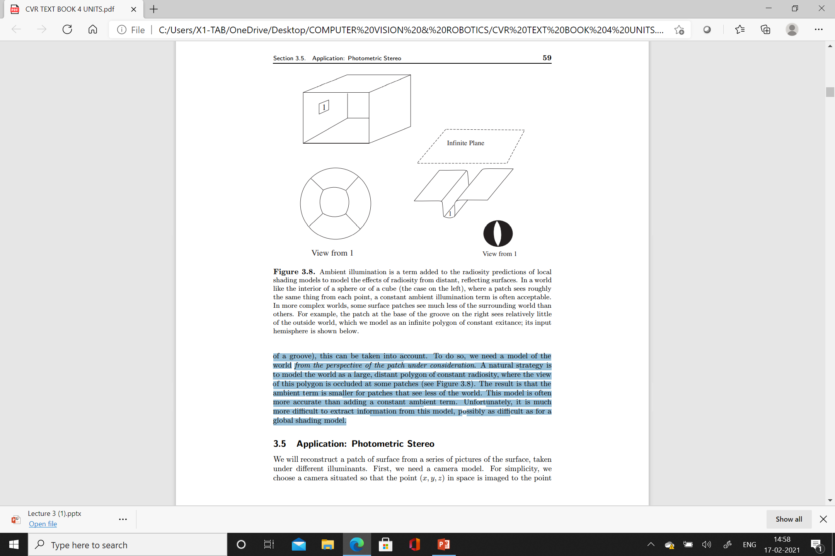

Slide 17
Photometric Stereo
Input – Several Images of the same object in different illumination conditions and same pose
Output - 3D shape of the object in the images
We can also determine the albedo of the surface and lighting
Consider Camera (x,y,z) projected in to (x,y) coordinate.
In this case the depth information is lost

Slide 18
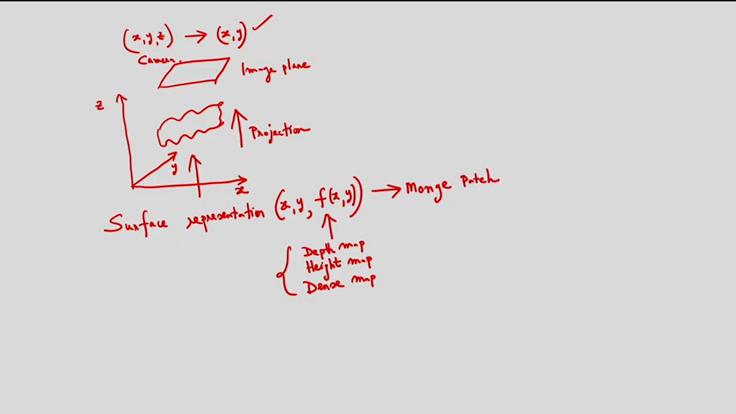

Slide 19
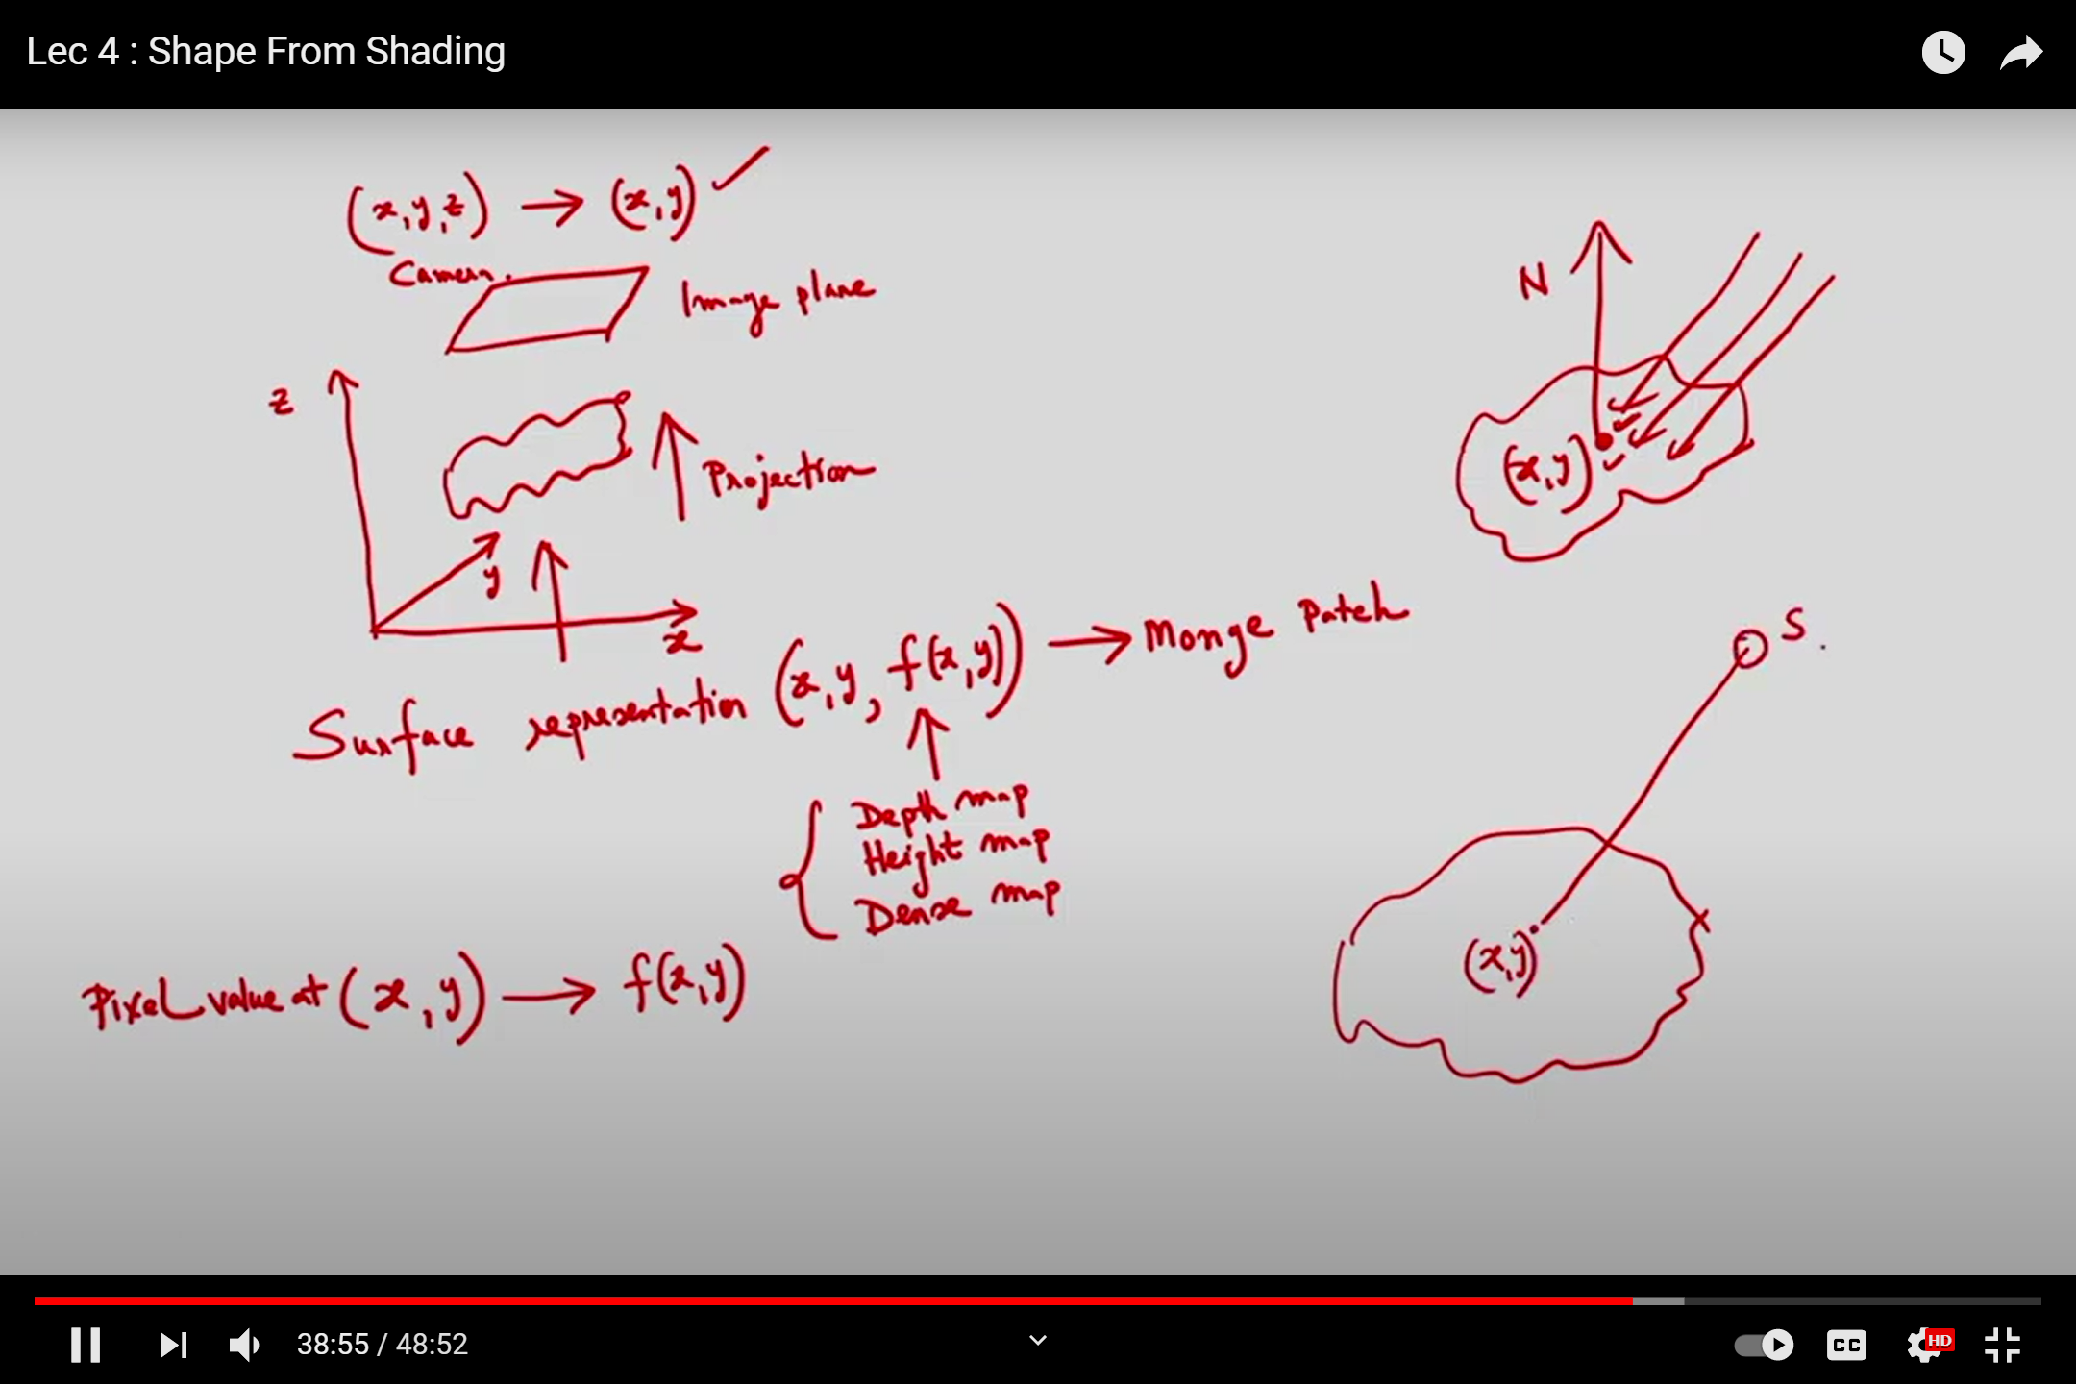
Representation of a surface is called as Monge patch
The Pixel (x,y) is actually f(x,y)
Photometric Stereo concept is , for different views i.e) we are considering number of light sources and we will see f(x,y) and find the depth map
The point (x,y) is illuminated by different light sources, from this I want to get the value of f(x,y) and from this I will get depth map

Slide 20
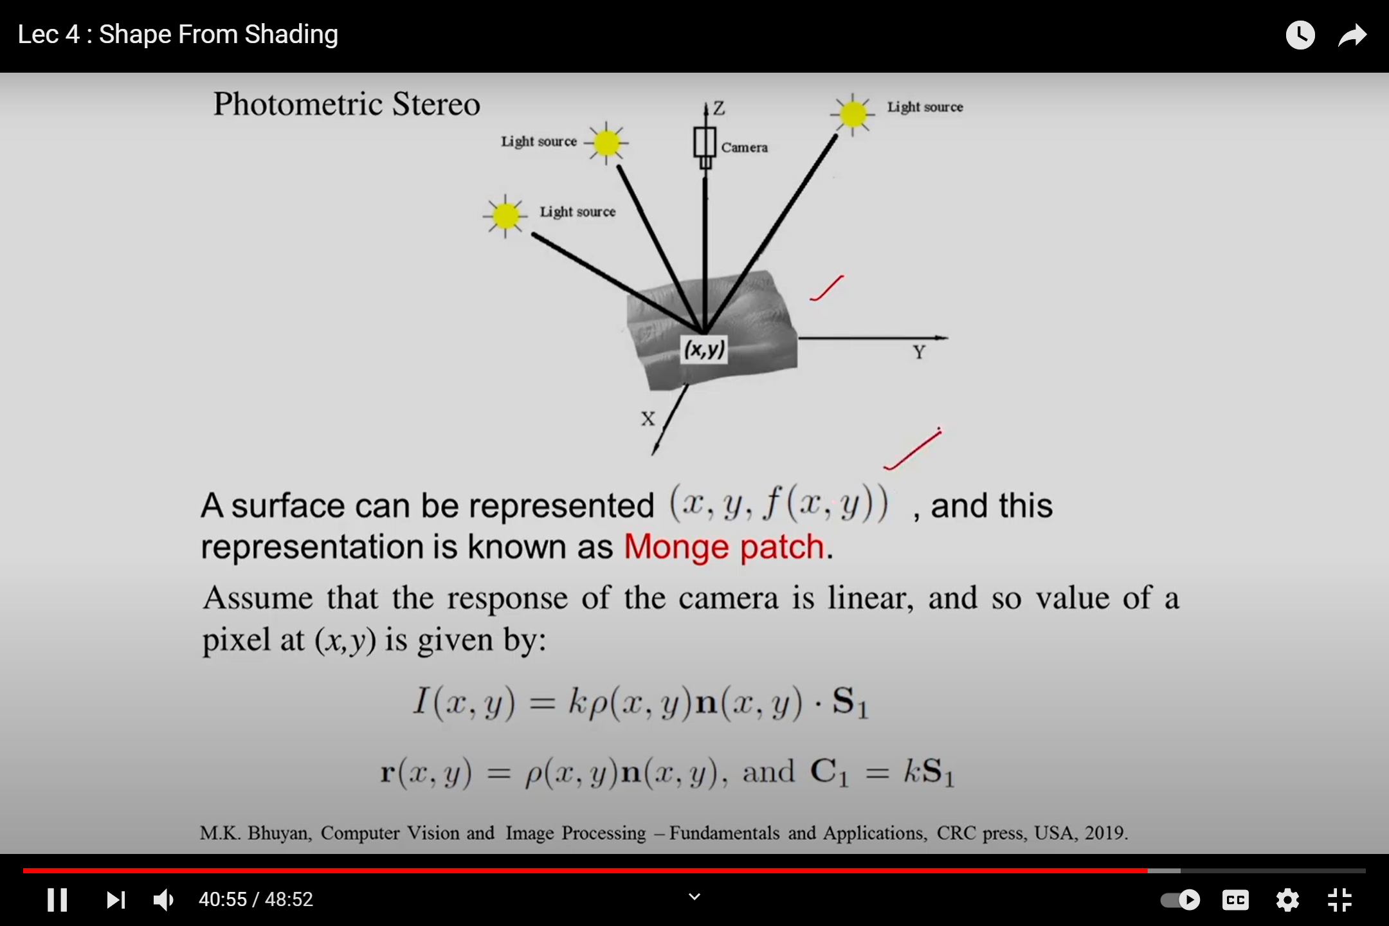
Photometric stereo setup

Slide 21
Consider the surface
Light is coming from the source corresponding to the point (x,y)
Consider light sources s1,s2,s3…
So we are getting number of images
Image we got in the image plane is I(x,y)
Only at a particular time only one light source is considered. For this I am using occluder
Corresponding to the light source S1, I am getting an image .
Let it be I1(x,y)…similarly we get images by considering different light sources
Let it be I2(x,y), I3(x,y)
From this images I will get the depth map i.e f(x,y)

Slide 22
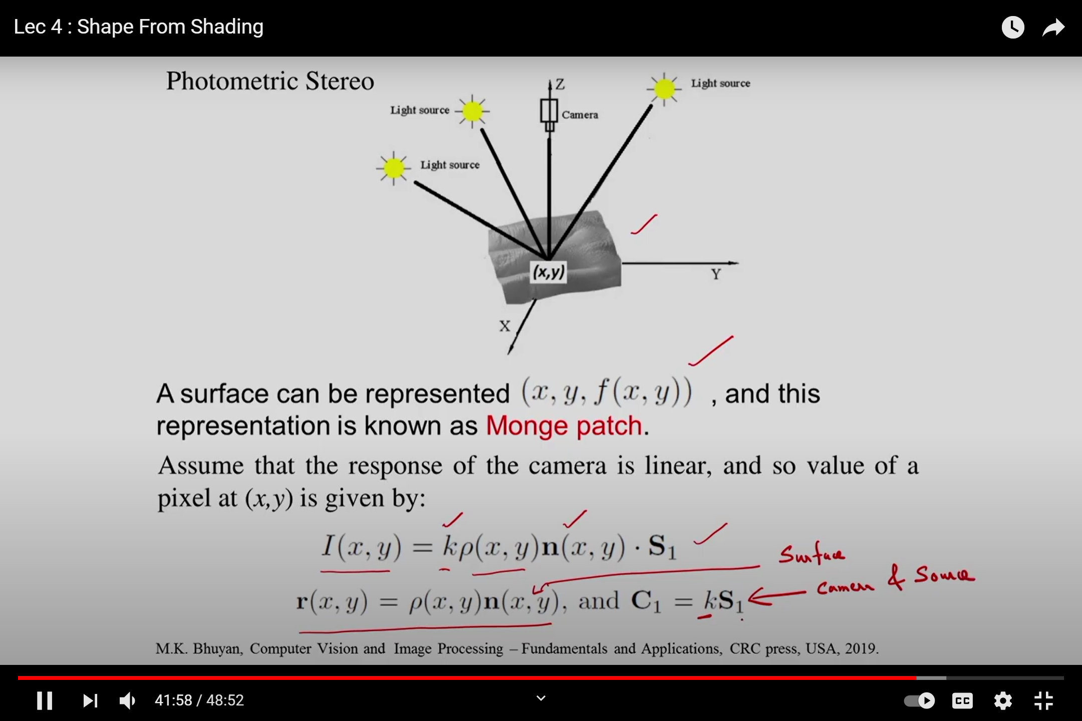
I(x,y) – Pixel of the image (x,y)
K- linearity
p(x,y) – surface albedo
n(x,y)- surface normal
S1-source vector
R(x,y) – surface characteristics
C1 – camera characteristics

Slide 23
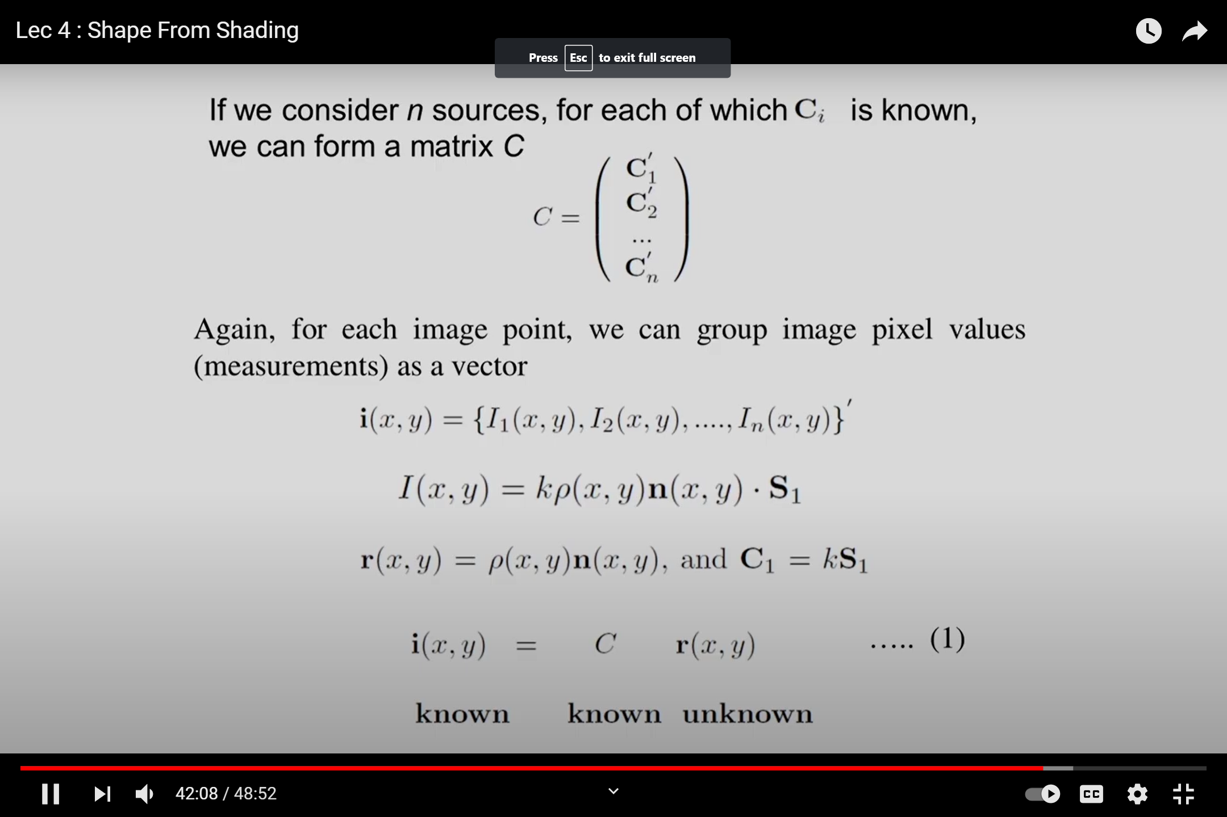

Slide 24
Consider n number of sources, for each source we get C
Corresponding to the sources I am getting the images I
Only one source at a particular time
R(x,y) – surface characteristics is unknown
We have to determine the Suface albedo * surface normal which will give r(x,y)
Main objective is to determine the surface normal
Because surface normal means it gives the orientation of the surface i.e) the shape of the surface can be determined

Slide 25
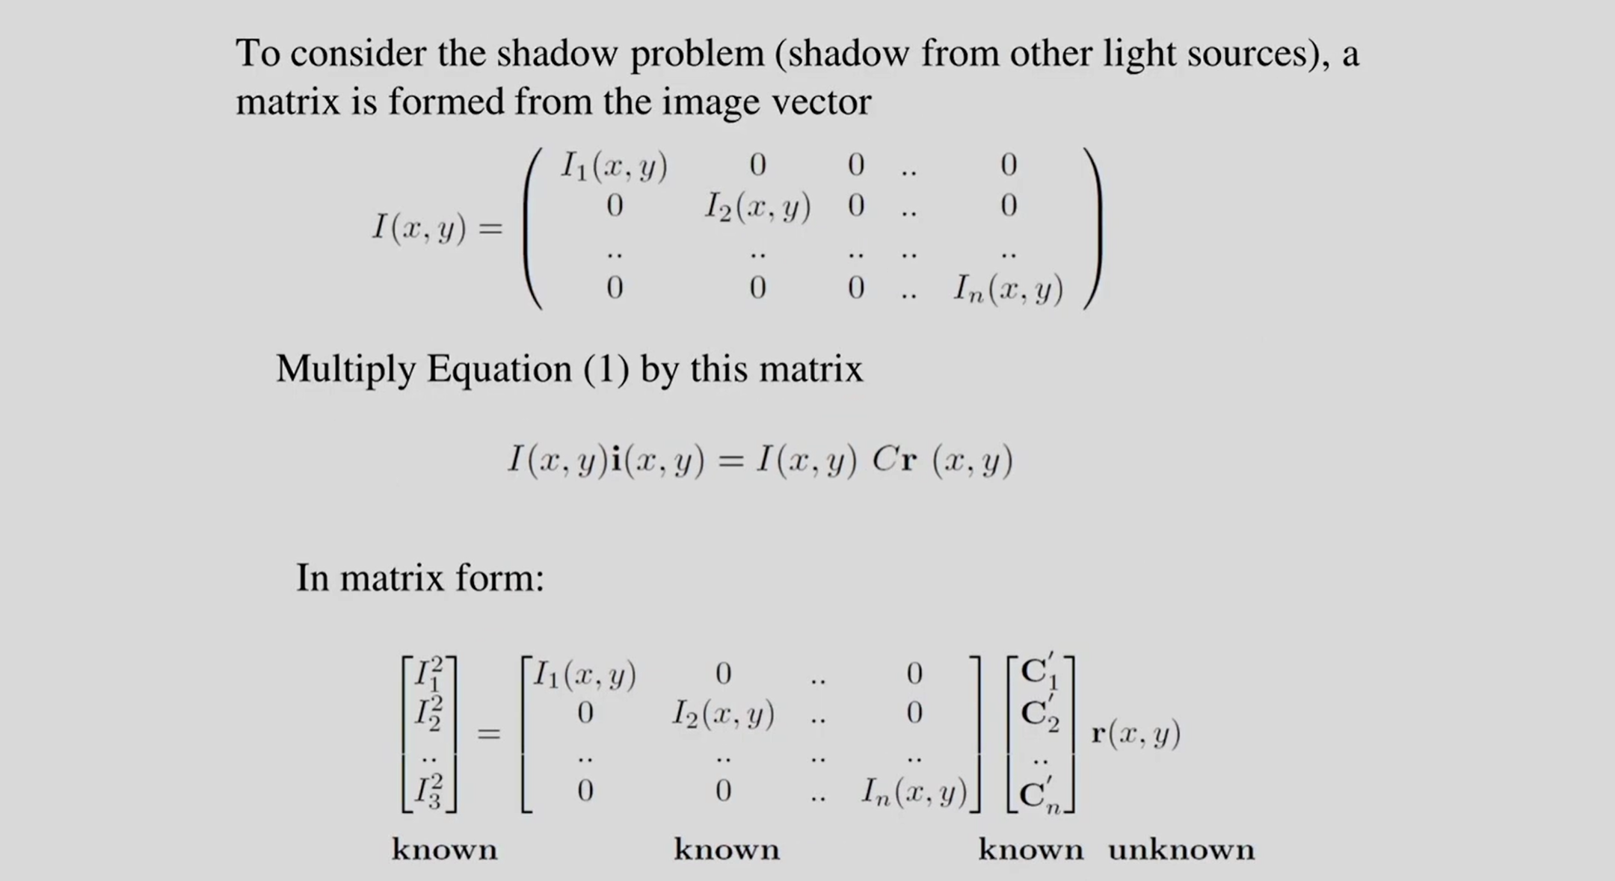

Slide 26
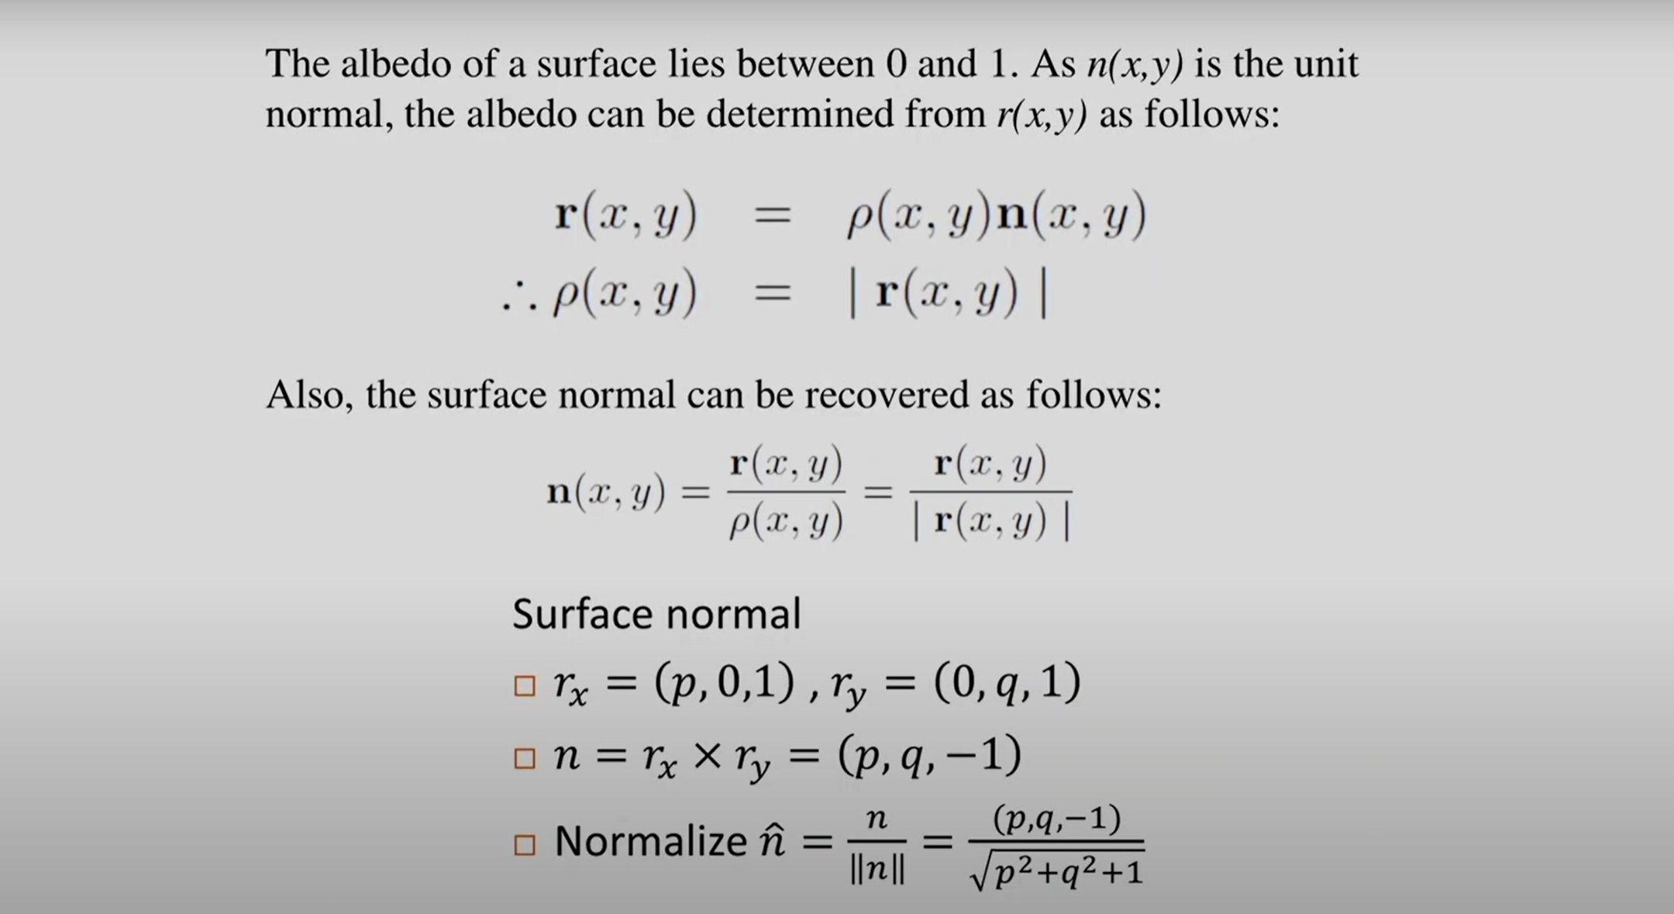

Slide 27
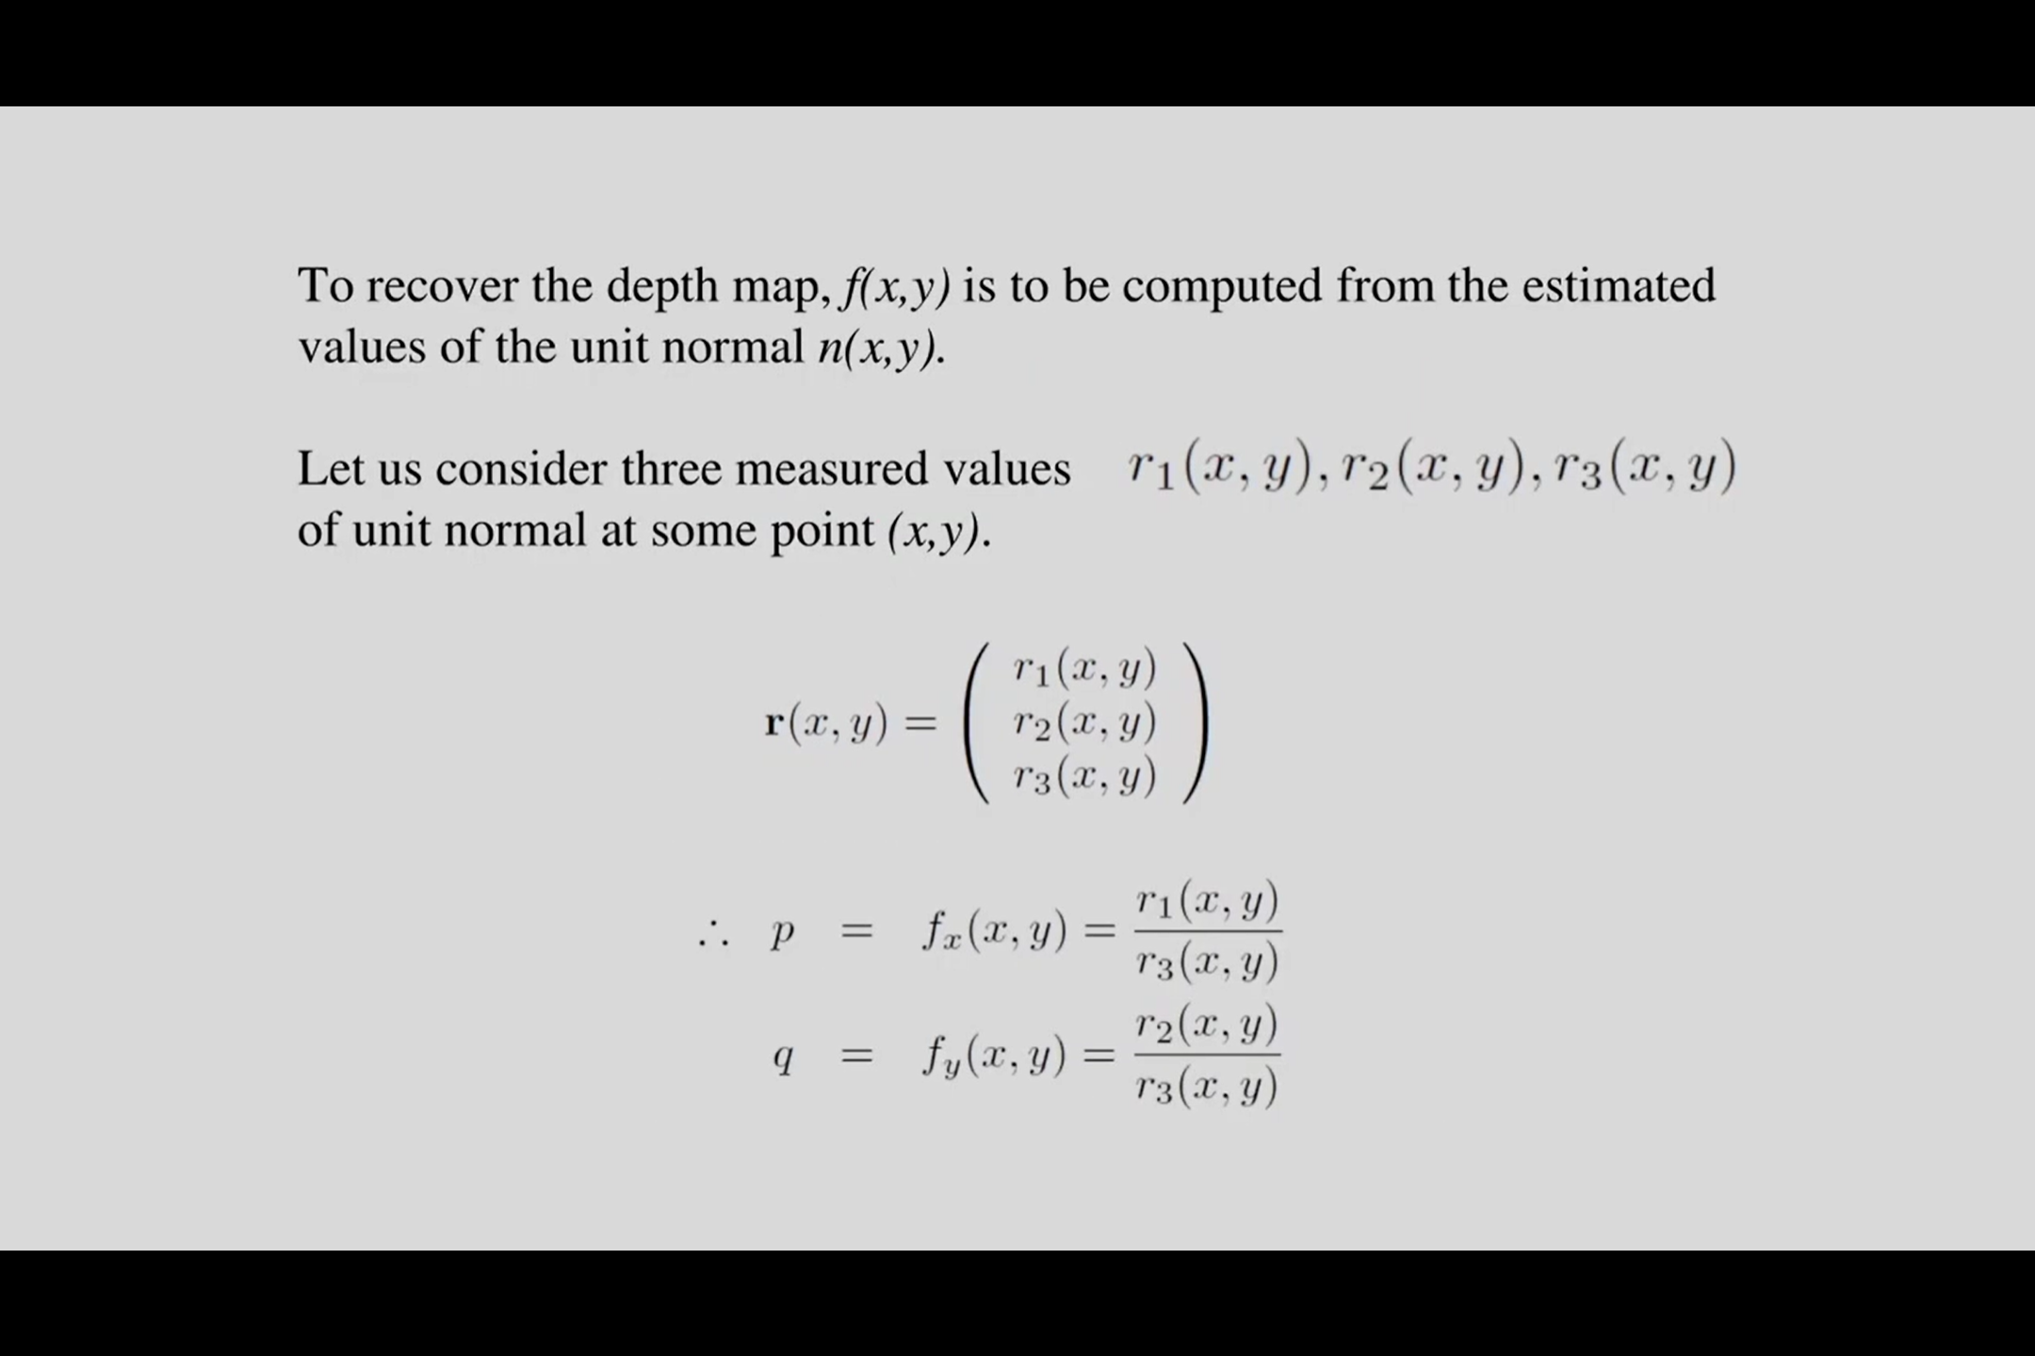

Slide 28
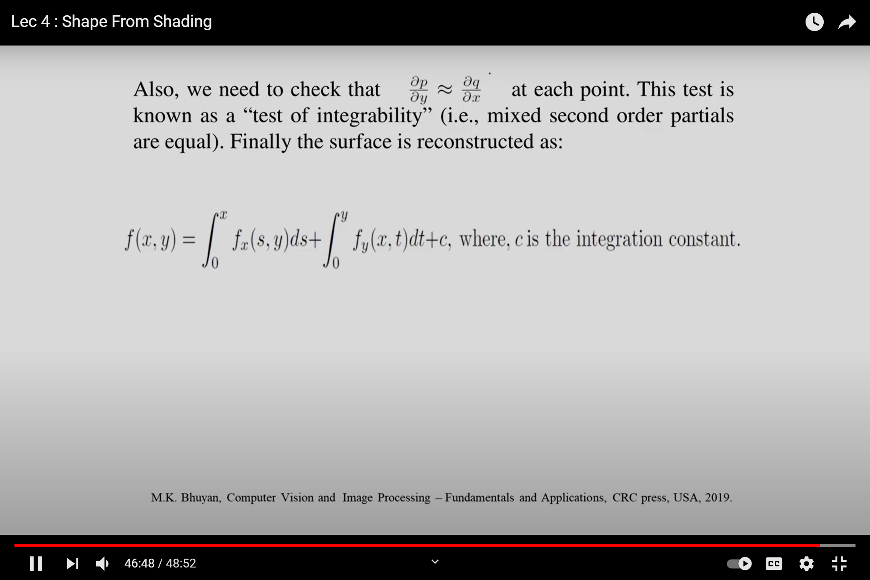

Slide 29
We have to consider this partial derivative of p with respect to y is approximately equal to partial derivative of q with respect to x.
This is called the test of integrability
Finally reconstruct the surface

Slide 30
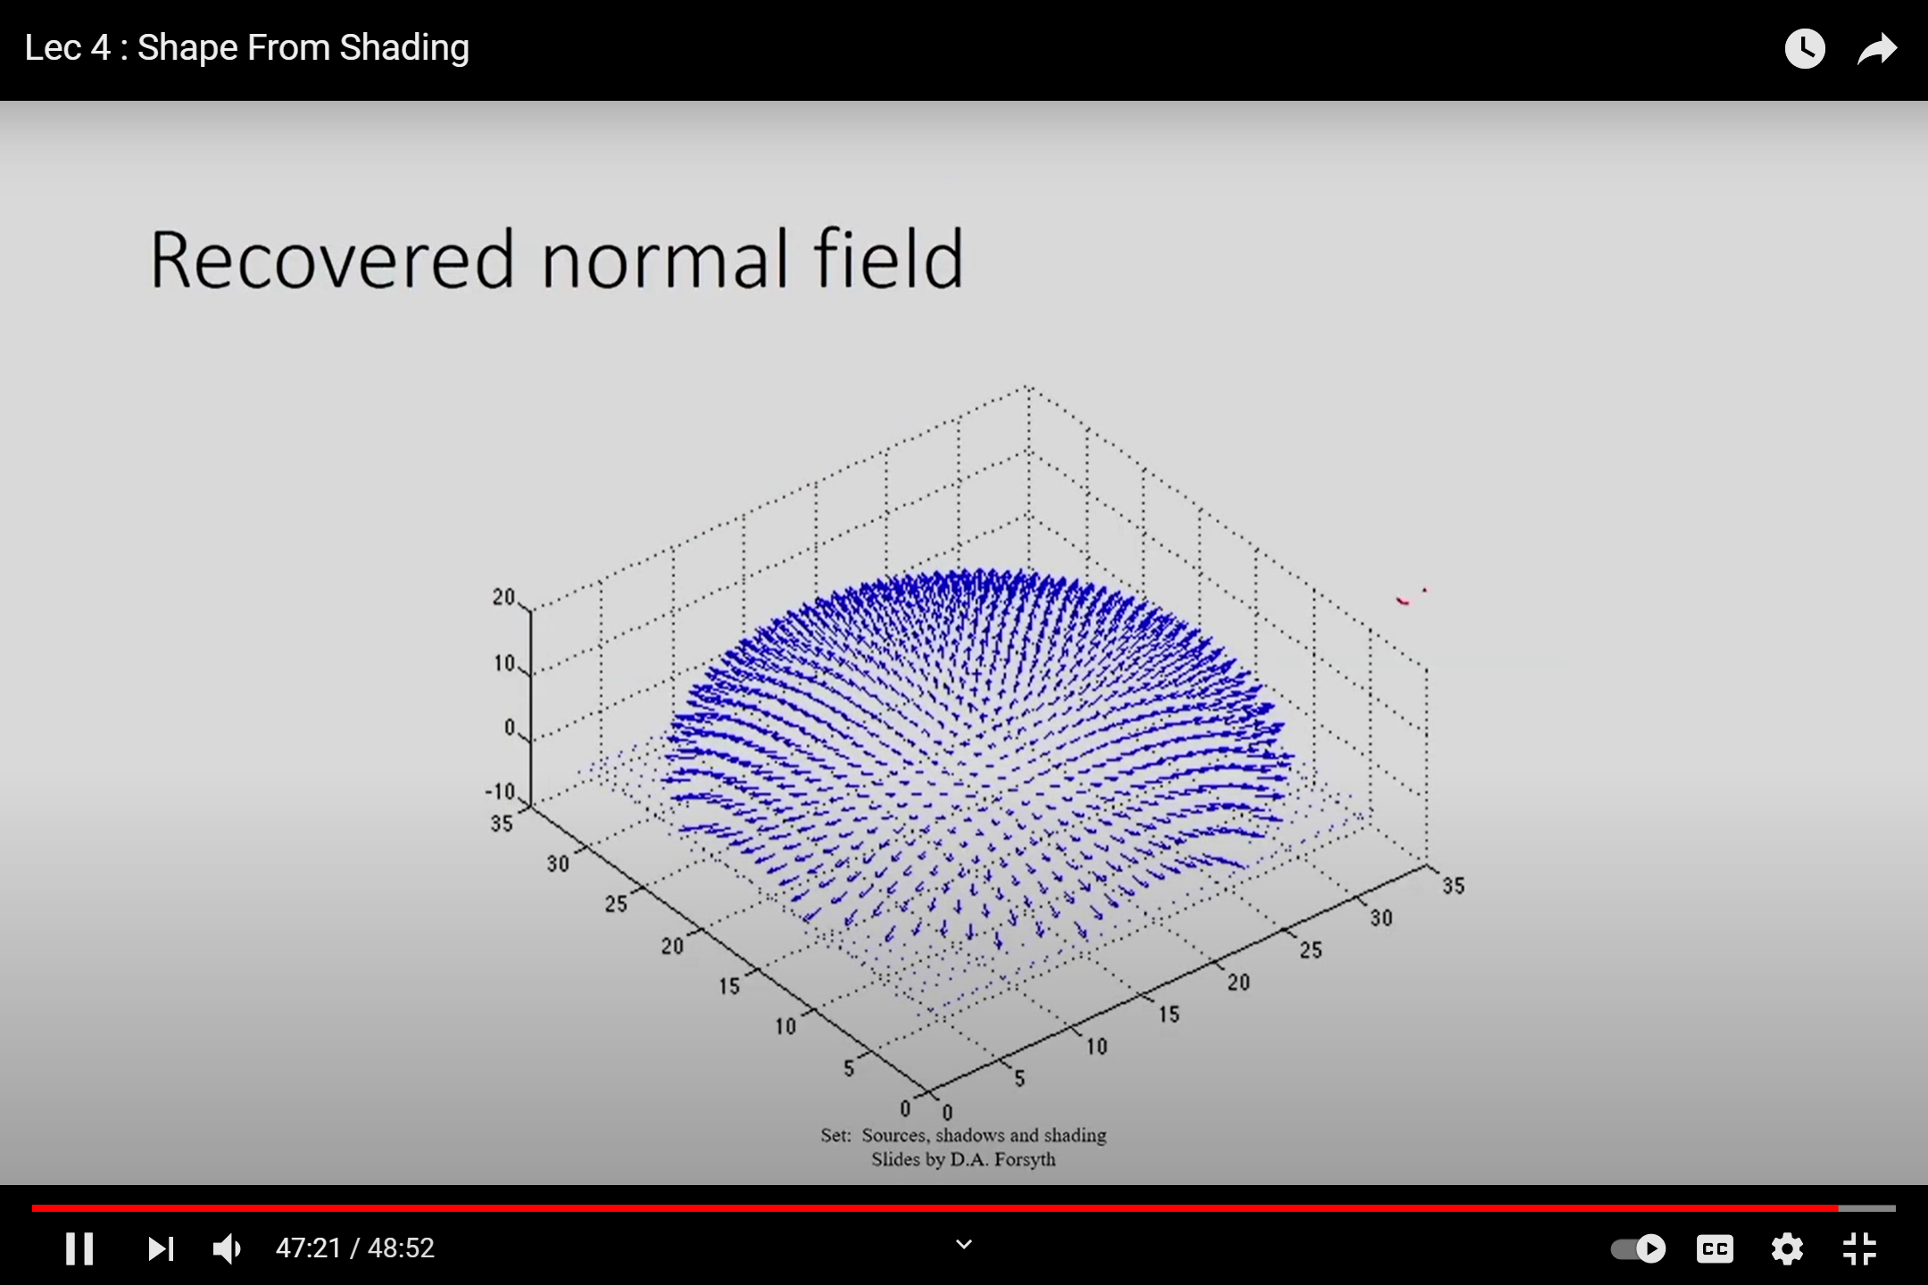

Slide 31
